Slide 1
Digital Portfolio
STUDENT NAME: Manikandan.P
REGISTER NO AND NMID: asunm1112401111033022
DEPARTMENT: BCA
COLLEGE: Loganatha Narayana Swamy Govt College,Ponneri.
University of Madras

Slide 2
PROJECT TITLE
Personal portfolio website

Slide 3
AGENDA
Problem Statement
Project Overview
End Users
Tools and Technologies
Portfolio design and Layout
Features and Functionality
Results and Screenshots
Conclusion
Github Link

Slide 4

PROBLEM STATEMENT
Many students and professionals struggle to present their skills, projects, and achievements in a structured and visually appealing way.

Slide 5

PROJECT OVERVIEW
This project focuses on creating a responsive portfolio website using HTML, CSS, and JavaScript to showcase personal and professional details.

Slide 6

WHO ARE THE END USERS?
Students seeking internships.
Professionals highlighting career achievements.
Freelancers presenting work to clients.

Slide 7

TOOLS AND TECHNIQUES
Frontend: HTML, CSS, JavaScript
Design Tools: Figma/Canva for layout planning
Version Control: Git & GitHub

Slide 8
POTFOLIO DESIGN AND LAYOUT
Clean, minimal, and responsive design.
Sections: Home, About, Skills, Projects, Contact.
8

Slide 9
FEATURES AND FUNCTIONALITY
Interactive navigation bar.
Project gallery with screenshots.
Contact form with validation.
Smooth scrolling and animations.

Slide 10
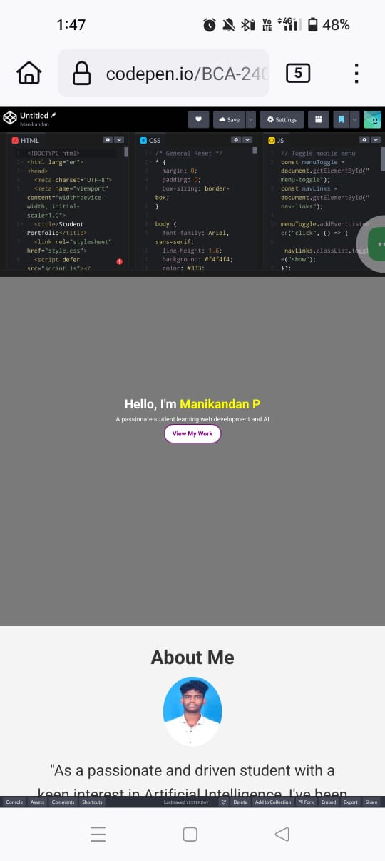

RESULTS AND SCREENSHOTS
3/21/2024 Annual Review
10

Slide 11
The final output is a fully functional portfolio website with modern UI/UX, optimized for mobile and desktop. Screenshots display the home page, project showcase, and contact form.

Slide 12
CONCLUSION
The portfolio enhances personal branding, helps in career opportunities, and serves as a digital identity.
12

Slide 13
Github Link
https://github.com/Manikandan5204/portfolio-1.git

